Slide 1
Search and Decoding in Speech Recognition
Automatic Speech Recognition

Slide 2
Automatic Speech Recognition
Spoken language understanding is a difficult task, and it is remarkable that humans do well at it.
The goal of automatic speech recognition ASR (ASR) research is to address this problem computationally by building systems that map from an acoustic signal to a string of words.
Automatic speech understanding (ASU) extends this goal to producing some sort of understanding of the sentence, rather than just the words.

Slide 3
Application Areas
The general problem of automatic transcription of speech by any speaker in any environment is still far from solved. But recent years have seen ASR technology mature to the point where it is viable in certain limited domains.
One major application area is in human-computer interaction.
While many tasks are better solved with visual or pointing interfaces, speech has the potential to be a better interface than the keyboard for tasks where full natural language communication is useful, or for which keyboards are not appropriate.
This includes hands-busy or eyes-busy applications, such as where the user has objects to manipulate or equipment to control.

Slide 4
Application Areas
Another important application area is telephony, where speech recognition is already used, for example
in spoken dialogue systems for entering digits, recognizing “yes” to accept collect calls,
finding out airplane or train information, and
call-routing (“Accounting, please”, “Prof. Regier, please”).
In some applications, a multimodal interface combining speech and pointing can be more efficient than a graphical user interface without speech (Cohen et al., 1998).

Slide 5
Application Areas
Finally, ASR is applied to dictation, that is, transcription of extended monologue by a single specific speaker. Dictation is common in fields such as law and is also important as part of augmentative communication (interaction between computers and humans with some disability resulting in
the inability to type, or
the inability to speak).
The blind Milton famously dictated Paradise Lost to his daughters, and Henry James dictated his later novels after a repetitive stress injury.

Slide 6
Parameters that define Speech Recognition Applications
One dimension of variation in speech recognition tasks is the vocabulary size.
Speech recognition is easier if the number of distinct words we need to recognize is smaller. So tasks with a two word vocabulary, like yes versus no detection, or an eleven word vocabulary, like recognizing sequences of digits, in what is called the digits task, are relatively easy.
On the other end, tasks with large vocabularies, like transcribing human-human telephone conversations, or transcribing broadcast news, tasks with vocabularies of 64,000 words or more, are much harder.

Slide 7
Parameters that define Speech Recognition Applications
A second dimension of variation is how fluent, natural, or conversational the speech is.
Isolated word recognition, in which each word is surrounded by some sort of pause, is much easier than recognizing
Continuous speech, in which words run into each other and have to be segmented. Continuous speech tasks themselves vary greatly in difficulty.
For example, human-to-machine speech turns out to be far easier to recognize than human-to-human speech. That is, recognizing speech of humans talking to machines, either
reading out loud in read speech (which simulates the dictation task), or
conversing with speech dialogue systems, is relatively easy.
Recognizing the speech of two humans talking to each other, in conversational speech recognition, for example for transcribing a business meeting or a telephone conversation, is much harder.
It seems that when humans talk to machines, they simplify their speech quite a bit talking more slowly and more clearly.

Slide 8
Parameters that define Speech Recognition Applications
A third dimension of variation is channel and noise.
Commercial dictation systems, and much laboratory research in speech recognition, is done with high quality, head mounted microphones.
Head mounted microphones eliminate the distortion that occurs in a table microphone as the speakers head moves around.
Noise of any kind also makes recognition harder. Thus recognizing a speaker dictating in a quiet office is much easier than recognizing a speaker dictating in a noisy car on the highway with the window open.

Slide 9
Parameters that define Speech Recognition Applications
A final dimension of variation is accent or speaker-class characteristics.
Speech is easier to recognize if the speaker is
speaking a standard dialect, or in general
one that matches the data the system was trained on.
Recognition is thus harder on foreign accented speech, or speech of children (unless the system was specifically trained on exactly these kinds of speech).

Slide 10
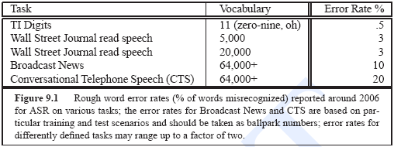
Performance of Speech Recognition on Various Tasks
Table 9.1 shows the rough percentage of incorrect words (the word error rate, or WER, defined on page 46) from state-of-the-art [around year 2000] systems on a range of different ASR tasks.

Slide 11
Performance of Speech Recognition on Various Tasks
Variation due to noise and accent increases the error rates quite a bit.
The word error rate on strongly Japanese-accented or Spanish accented English has been reported to be about 3 to 4 times higher than for native speakers on the same task (Tomokiyo, 2001).
Adding automobile noise with a 10dB SNR (signal-to-noise ratio) can cause error rates to go up by 2 to 4 times.
In general, these error rates go down every year, as speech recognition performance has improved quite steadily. One estimate is that performance has improved roughly 10 percent a year over the last decade (Deng and Huang, 2004), due to a combination of algorithmic improvements and Moore’s law!

Slide 12
Fundamentals of LVCSR
Focus of this chapter is on the fundamentals of one crucial area: Large-Vocabulary Continuous Speech Recognition (LVCSR).
Large vocabulary generally means that the systems have a vocabulary of roughly 20,000 to 60,000 words.
We saw above that continuous means that the words are run together naturally.
Furthermore, the algorithms we will discuss are generally speaker independent; that is, they are able to recognize speech from people whose speech the system has never been exposed to before.

Slide 13
LVCSR and HMM’s
The dominant paradigm for LVCSR is the HMM, and we will focus on this approach in this chapter.
Previous lectures have introduced the key phonetic and phonological notions of phone, syllable, and intonation.
In ECE 5527 we have introduced the N-gram language model and the perplexity metric.
In this chapter we begin with an overview of the architecture for HMM speech recognition:
offer a brief overview of signal processing for feature extraction and the extraction of the important MFCC features, and then introduce
Gaussian acoustic models.
We then continue with how Viterbi decoding works in the ASR context, and give a complete summary of the training procedure for ASR, called embedded training.
Finally, we introduce word error rate, the standard evaluation metric.

Slide 14
Speech Recognition Systems Architecture

Slide 15
Speech Recognition Systems Architecture
The task of speech recognition is to take as input an acoustic waveform and produce as output a string of words.
HMM-based speech recognition systems view this task using the metaphor of the noisy channel. The intuition of the noisy channel model is to treat the acoustic waveform as a “noisy” version of the string of words, i.e.. a version that has been passed through a noisy communications channel

Slide 16

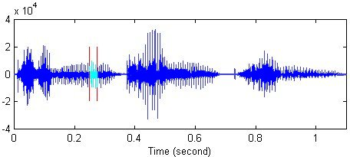
“Noisy Channel” View of SR
“The learning and knowledge that we have, is, at the most, but little compared with that of which we are ignorant !” …
ASR Decoder
Noise
The leaning over the edge … The leaning over the hedge … The learning and knowledge …
Guess at Original Sentence: “The learning and knowledge that we have … “

Slide 17
“Noisy Channel” View of SR
This channel introduces “noise” which makes it hard to recognize the “true” string of words. Our goal is then to build a model of the channel so that we can figure out how it modified this “true” sentence and hence recover it.
“Noise Channel” view absorbs all variability's of the speech mentioned earlier including true noise.
Having insight of the noisy channel model means that we know how the channel distorts the source, we could find the correct source sentence for a waveform by taking every possible sentence in the language, running each sentence through our noisy channel model, and seeing if it matches the output.
We then select the best matching source sentence as our desired source sentence.

Slide 18
“Noisy Channel” View of SR
Implementing the noisy-channel model as we have expressed it in previous slide requires solutions to two problems.
First, in order to pick the sentence that best matches the noisy input we will need a complete metric for a “best match”. Because speech is so variable, an acoustic input sentence will never exactly match any model we have for this sentence. As we have suggested in previous chapters, we will use probability as our metric.

Slide 19
“Noisy Channel” View of SR
This makes the speech recognition problem a special case of Bayesian inference, a method known since the work of Bayes (1763).
Bayesian inference or Bayesian classification was applied successfully by the 1950s to language problems like optical character recognition (Bledsoe and Browning, 1959) and to authorship attribution tasks like the seminal work of Mosteller and Wallace (1964) on determining the authorship of the Federalist papers.
Our goal will be to combine various probabilistic models to get a complete estimate for the probability of a noisy acoustic observation-sequence given a candidate source sentence. We can then search through the space of all sentences, and choose the source sentence with the highest probability.

Slide 20
“Noisy Channel” View of SR
The decoding or search problem. Since the set of all English sentences is huge, we need an efficient algorithm that will not search through all possible sentences, but only ones that have a good chance of matching the input.
Since the search space is so large in speech recognition, efficient search is an important part of the task, and we will focus on a number of areas in search.
In the rest of this introduction we will review the probabilistic or Bayesian model for speech recognition. We then introduce the various components of a modern HMM-based ASR system.

Slide 21
Information Theoretic Approach to ASR

Slide 22
Information Theoretic Approach to ASR
Goal of the probabilistic noisy channel architecture for speech recognition can be stated as follows:
What is the most likely sentence out of all sentences in the language L given some acoustic input O?
We can treat the acoustic input O as a sequence of individual “symbols” or “observations”:
For example by slicing up the input every 10 milliseconds, and representing each slice by floating-point values of the energy or frequencies of that slice.
Each index then represents some time interval, and successive o_{i} indicate temporally consecutive slices of the input (note that capital letters will stand for sequences of symbols and lower-case letters for individual symbols):

Slide 23
Information Theoretic Approach to ASR
Assume that O is a sequence of symbols taken from some alphabet A.
W – denotes a string of n words each belonging to a fixed and known vocabulary V.
Both of these are simplifying assumptions; for example dividing sentences into words is sometimes:
too fine a division (we’d like to model facts about groups of words rather than individual words) and sometimes
too gross a division (we need to deal with morphology).
Usually in speech recognition a word is defined by orthography (after mapping every word to lower-case):
oak is treated as a different word than oaks, but the auxiliary can (“can you tell me. . . ”) is treated as the same word as the noun can (“I need a can of. . . ” ).

Slide 24
Information Theoretic Approach to ASR
If P(W|O) denotes the probability that the words W were spoken, given that the evidence O was observed, then the recognizer should decide in favor of a word string W satisfying:
The recognizer will pick the most likely word string given the observed acoustic evidence.
Recall that the function argmax_{x} f (x) means “the x such that f(x) is largest”. Equation is guaranteed to give us the optimal sentence W;
We now need to make the equation operational. That is, for a given sentence W and acoustic sequence O we need to compute P(W|O) .

Slide 25
Information Theoretic Approach to ASR
From the well known Bayes’ rule of probability theory:
P(W) – Probability that the word string W will be uttered
P(O|W) – Probability that when W was uttered the acoustic evidence O will be observed
P(O) – is the average probability that O will be observed:

Slide 26
Information Theoretic Approach to ASR
Since Maximization in:
Is carried out with the variable O fixed (e.g., there is no other acoustic data save the one we are given), it follows from Baye’s rule that the recognizer’s aim is to find the word string Ŵ that maximizes the product P(O |W)P(W), that is

Slide 27
Information Theoretic Approach to ASR
The probabilities on the right-hand side of the last equation presented in previous slide are for the most part easier to compute than P(W|O).
For example, P(W), the prior probability of the word string itself is exactly what is estimated by the N-gram language models.
And we will see next that P(O|W) turns out to be easy to estimate as well.
But P(O), the probability of the acoustic observation sequence, turns out to be harder to estimate.
Luckily, we can ignore P(O). Why?
Since we are maximizing over all possible sentences, we will be computing P(O|W)P(W)/P(O) for each sentence in the language.
P(O) doesn’t change for each sentence! For each potential sentence we are still examining the same observations O, which must have the same probability P(O). Thus:

Slide 28
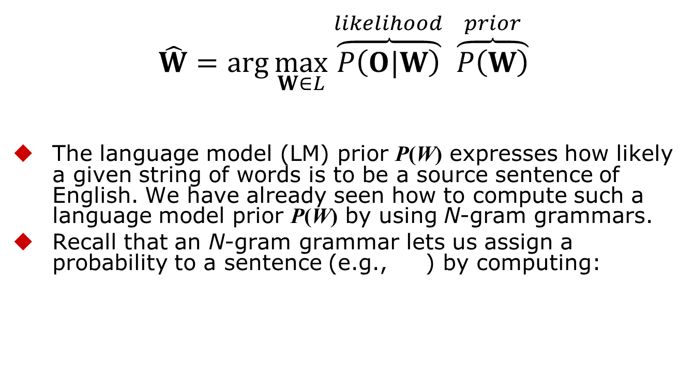
Information Theoretic Approach to ASR
$$\hat{W}=\arg{\max_{W∈L}{\overset{likelihood}{\overbrace{P\left(O|W\right)}}}} \overset{prior}{\overbrace{P\left(W\right)}}$$
The language model (LM) prior P(W) expresses how likely a given string of words is to be a source sentence of English. We have already seen how to compute such a language model prior P(W) by using N-gram grammars.
Recall that an N-gram grammar lets us assign a probability to a sentence (e.g., ) by computing:

Slide 29
Information Theoretic Approach to ASR
This chapter will show how the HMM can be used to build an Acoustic Model (AM) which computes the likelihood P(O|W).
Given the AM and LM probabilities, the probabilistic model can be operationalized in a search algorithm so as to compute the maximum probability word string for a given acoustic waveform.
Figure presented in the next slide shows a rough block diagram of how the computation of the prior and likelihood fits into a recognizer decoding a sentence.

Slide 30
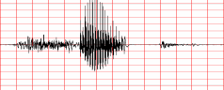
Block Diagram of Speech Recognition Processing
Acoustic Model & Lexicon
P(O|W)
Speaker's Mind
Speech Producer
Acoustic Processor
Decoding Search
W
Speech
O
Ŵ
Speaker
Acoustic Channel
Speech Recognizer
P(W)
Language Model

Slide 31
Decoding and Search
We can see further details of the operationalization in Figure presented in the next slide, which shows the components of an HMM speech recognizer as it processes a single utterance.
The figure shows the recognition process in three stages.
In the feature extraction or signal processing stage, the acoustic waveform is sampled into frames (usually of 5, 10, 15, 20, 25 or 30 milliseconds) which are transformed into spectral features.
Each time window is thus represented by a vector of around 39 features (13+13+13 => static + first + second derivatives dynamic features) representing this spectral information as well as information about energy and spectral change.

Slide 32
Schematic Simplified Architecture of Speech Recognizer

Slide 33
Decoding and Search
In the acoustic modeling or phone recognition stage, we compute the likelihood of the observed spectral feature vectors given linguistic units (words, phones, subparts of phones).
For example, we use Gaussian Mixture Model (GMM) classifiers to compute for each HMM state q, corresponding to a phone or subphone, the likelihood of a given feature vector given this phone p(o|q).
A (simplified) way of thinking of the output of this stage is as a sequence of probability vectors, one for each time frame, each vector at each time frame containing the likelihoods that each phone or subphone unit generated the acoustic feature vector observation at that time.

Slide 34
Decoding and Search
Finally, in the decoding phase, we take
the acoustic model (AM), which consists of this sequence of acoustic likelihoods, plus
an HMM dictionary of word pronunciations, combined with the language model (LM) (generally an N-gram grammar), and output the most likely sequence of words.
An HMM dictionary, as we will see in Sec. 9.2, is a list of word pronunciations, each pronunciation represented by a string of phones.
Each word can then be thought of as an HMM, where the phones (or sometimes subphones) are states in the HMM, and the Gaussian likelihood estimators supply the HMM output likelihood function for each state. Most ASR systems use the Viterbi algorithm for decoding, speeding up the decoding with wide variety of sophisticated augmentations such as pruning, fast-match, and tree-structured lexicons.

Slide 35
Hidden Markov Model
Applying the Hidden Markov Model to Speech

Slide 36
Notation
N: number of states in the model
Set of states Q = {q₁,q₂,...,q_{N}}
state at time t, q_{t} ∈ Q
M: number of observations defining a set of observations O each one drawn from a vocabulary V
O = o₁,o₂,...,o_{M}
V = {v₁,v₂,...,v_{M} }
observation at time t, o_{t} ∈ V

Slide 37
Notation
A = {a_{ij}}: state transition probability distribution matrix
a_{ij} = P(Q_{t+1}=q_{j}|Q_{t}=q_{i}), 1 ≤ i,j ≤ N
B = {b_{j}(o_{t})}: A set of observation symbol probability distribution also called emission probabilities
b_{j}(o_{t}) = P(o_{t}|q_{j} ), 1 ≤ j ≤ N
π = {π_{i}}: initial state distribution
π_{i} = P(q_{i}) 1 ≤ i ≤ N
A special start and end state which are not associated with observations.
q₀, q_{e}

Slide 38
Notation
HMM is typically written as: λ = {A, B, π}
This notation also defines/includes the probability measure for O, i.e., P(O|λ)

Slide 39
Example of HMM for Speech Recognition
What are states used for and what do they model?
For speech the (hidden) states can be
Phones,
Parts of speech, or
Words

Slide 40
Example of HMM for Speech Recognition
Observation is information about the spectrum and energy of waveform at a point in time.
Decoding process maps this sequence of acoustic information to phones and words.
The observation sequence for speech recognition is a sequence of acoustic feature vectors. Each acoustic feature vector represents information such as the amount of energy in different frequency bands at a particular point in time.
Sec. 9.3 details further to the nature of these observations, but for now we’ll simply note that each observation consists of a vector of 39 real-valued features indicating spectral information.
Observations are generally drawn every 10 milliseconds, so 1 second of speech requires 100 spectral feature vectors, each vector of length 39.

Slide 41
Hidden States of HMM
The hidden states of Hidden Markov Models can be used to model speech in a number of different ways.
For small tasks, like
digit recognition, (the recognition of the 10 digit words zero through nine), or for
yes-no recognition (recognition of the two words yes and no),
we could build an HMM whose states correspond to entire words.
For most larger tasks, however, the hidden states of the HMM correspond to phone-like units, and words are sequences of these phone-like units

Slide 42
Example of HMM
An HMM for the word six, consisting of four emitting states and two non-emitting states, the transition probabilities A, the observation probabilities B, and a sample observation sequence.
This kind of left-to-right HMM structure is called a Bakis network.

Slide 43
Duration Modeling
The use of self-loops allows a single phone to repeat so as to cover a variable amount of the acoustic input.
Phone durations vary hugely, dependent on
the phone identity,
the speaker’s rate of speech,
the phonetic context, and
the level of prosodic prominence of the word.
Looking at the Switchboard corpus,
the phone [aa] varies in length from 7 to 387 milliseconds (1 to 40 frames), while
the phone [z] varies in duration from 7 milliseconds to more than 1.3 seconds (130 frames) in some utterances!
Self-loops thus allow a single state to be repeated many times.

Slide 44
What HMM’s States Model?
For very simple speech tasks (recognizing small numbers of words such as the 10 digits), using an HMM state to represent a phone is sufficient.
In general LVCSR tasks, however, a more fine-grained representation is necessary. This is because phones can last over 1 second, i.e., over 100 frames, but the 100 frames are not acoustically identical. The spectral characteristics of a phone, and the amount of energy, vary dramatically across a phone.
For example, recall that stop consonants have a closure portion, which has very little acoustic energy, followed by a release burst.
Similarly, diphthongs are vowels whose F1 and F2 change significantly.
Fig. 9.6 shows these large changes in spectral characteristics over time for each of the two phones in the word “Ike”, ARPAbet [ay k].

Slide 45
Ike [ay k]

Slide 46
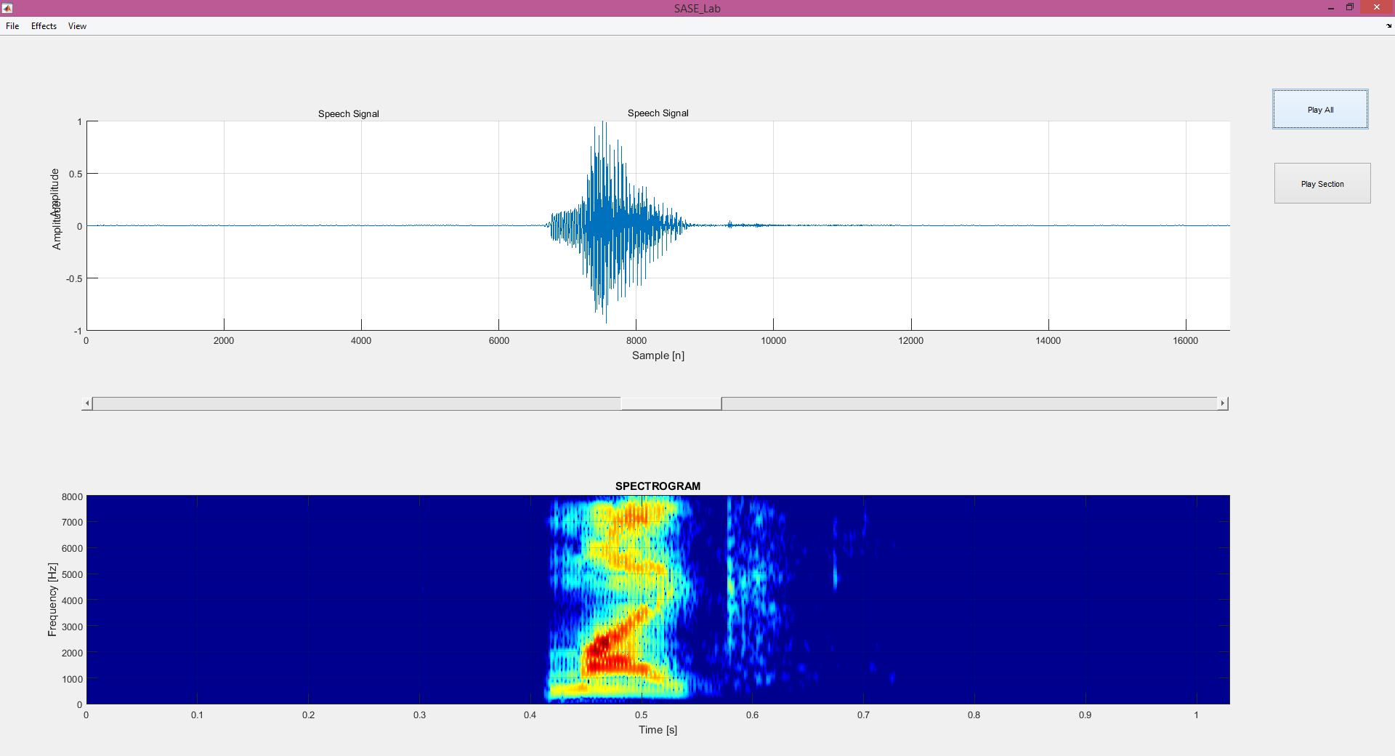
Spectrogram of Mike – [m ay k]

Slide 47
Phone Modeling with HMMs
To capture this fact about the non-homogeneous nature of phones over time, in LVCSR we generally model a phone with more than one HMM state. The most common configuration is to use three HMM states,
a beginning,
middle, and
end state.
Each phone thus consists of 3 emitting HMM states instead of one (plus two non-emitting states at either end), as shown in next slide.
It is common to reserve the word model or phone model to refer to the entire 5-state phone HMM, and use the word HMM state (or just state for short) to refer to each of the 3 individual sub-phone HMM states.

Slide 48
Phone Modeling with HMMs
A standard 5-state HMM model for a phone, consisting of three emitting states (corresponding to the transition-in, steady state, and transition-out regions of the phone) and two non-emitting states.

Slide 49
Phone Modeling with HMMs
To build a HMM for an entire word using these more complex phone models, we can simply replace each phone of the word model in Example of HMM for Speech Recognition with a 3-state phone HMM.
We replace the non-emitting start and end states for each phone model with transitions directly to the emitting state of the preceding and following phone, leaving only two non-emitting states for the entire word.
Figure in the next slide shows the expanded word.

Slide 50
Phone Modeling with HMMs
A composite word model for “six”, [s ih k s], formed by concatenating four phone models, each with three emitting states.

Slide 51
Six ([s ɪ k s] or [s ih k s])

Slide 52
Phone Modeling with HMMs
Another way of looking at the A – transitional probabilities and the states Q is that together they represent a lexicon: a set of pronunciations for words, each pronunciation consisting of a set of sub-phones, with the order of the sub-phones specified by the transition probabilities A.

Slide 53
Phone Modeling with HMMs
We have now covered the basic structure of HMM states for representing phones and words in speech recognition. Later in this chapter we will see further augmentations of the HMM word model shown in the Figure in previous slide, such as
the use of triphone models which make use of phone context, and
the use of special phones to model silence.

Slide 54
Acoustic Observations
Acoustic Observations

Slide 55
Acoustic Observations
First, though, we need to turn to the next component of HMMs for speech recognition:
The observation likelihoods. And in order to discuss observation likelihoods, we first need to introduce the actual acoustic observations: feature vectors.
After discussing these in Sec. 9.3, we turn in Sec. 9.4 the acoustic model and details of observation likelihood computation.
We then re-introduce Viterbi decoding and show how the acoustic model and language model are combined to choose the best sentence

Slide 56
Feature Extraction
MFCC Vectors

Slide 57
Feature Extraction: MFCC Vectors
Feature Vectors:
Our goal in this section is to describe how we transform the input waveform into a sequence of acoustic feature vectors, each vector representing the information in a small time window of the signal. While there are many possible such feature representations, MFCC by far is the most common in speech recognition: the mel frequency cepstral coefficients.
Mel Frequency Cepstral Coefficients
These are based on the important idea of the cepstrum. We will give a relatively high-level description of the process of extraction of MFCCs from a waveform; we strongly encourage students interested in more detail to follow up with a speech signal processing course.

Slide 58
MFCC Feature Extraction
Extracting a sequence of 39-dimensional MFCC feature vectors from a quantized digitized waveform

Slide 59
Feature Extraction: MFCC Vectors
Analog-to-Digital Conversion
We begin with the process of digitizing and quantizing an analog speech waveform. Recall that the first step in processing speech is to convert the analog representations (first air pressure, and then analog electric signals in a microphone), into a digital signal. This process of analog-to-digital conversion has two steps:
sampling and
quantization.
Sampling, Sampling Rate, Nyqist Frequency:
A signal is sampled by measuring its amplitude at a particular time; the sampling rate is the number of samples taken per second. In order to accurately measure a wave, it is necessary to have at least two samples in each cycle: one measuring the positive part of the wave and one measuring the negative part.
More than two samples per cycle increases the amplitude accuracy, but less than two samples will cause the frequency of the wave to be completely missed. Thus the maximum frequency wave that can be measured is one whose frequency is half the sample rate (since every cycle needs two samples). This maximum frequency for a given sampling rate is called the Nyquist frequency.

Slide 60
Bandwidth and Sample Rate
Most information in human speech is in frequencies below 10,000 Hz; thus a 20,000 Hz sampling rate would be necessary for complete accuracy.
But telephone speech is filtered by the switching network, and only frequencies less than 4,000 Hz are transmitted by telephones. Thus an 8,000 Hz sampling rate is sufficient for telephone-bandwidth speech like the Switchboard corpus.
A 16,000 Hz sampling rate (sometimes called wideband) is often used for microphone speech.

Slide 61
Computing Acoustic Likelihoods

Slide 62
Computing Acoustic Likelihoods
Given the sequence of feature vectors produced by the process depicted in the previous section we are ready to show how to use HMM’s and its B probability function to compute output likelihoods.
Given an individual state q_{i} and an observation o_{t}, the observation likelihoods in B matrix give us p(o_{t}|q_{i}), which we called b_{i}(o_{t}).
For part-of-speech tagging partially discussed in previous chapters, each observation o_{t} is a discrete symbol (e.g., a word) and we can compute the likelihood of an observation given a part-of-speech tag just by counting the number of times a given tag generates a given observation in the training set.

Slide 63
Computing Acoustic Likelihoods
For speech recognition on the other hand, observation sequence are MFCC real-valued vectors of numbers, thus we can NOT compute the likelihood of a given state (phone) generating an MFCC vector by counting the number of times each vector occurs.
We need a decoding and training procedure that can compute observation likelihood function p(o_{t}|q_{i}), from a real-valued observations.
In decoding we are given an observation o_{t} and we need to produce the probability p(o_{t}|q_{i}) for each possible HMM state, from which we can choose the most likely sequence of states.
Once we have this observation likelihood B function we need to apply a modified Baum-Welch algorithm to train HMM.

Slide 64
Gaussian PDFs
A method to model probability density functions or pdfs for continuous real-valued observations.
By far the most common method for computing acoustic likelihoods is the Gaussian Mixture Model (GMM) pdfs.
Other methods were used based on:
Neural Networks
Support Vector Machines (SVMs),
Conditional Random Fields (CRFs).

Slide 65
Univariate Gaussians
The Gaussian distribution, also known as the normal distribution, is the bell-curve function familiar from basic statistics.
A Gaussian distribution is a function parameterized by a mean, or average value, and a variance, which characterizes the average spread or dispersal from the mean.
We will use μ to indicate the mean, and σ² to indicate the variance, giving the following formula for a Gaussian function:

Slide 66
Univariate Gaussian PDFs

Slide 67
Example of Composite pdf

Slide 68
Gaussian PDFs
Mean of a Random variable X is the expected value of X.
For a discrete variable X. this is the weighted sum over the values of X:
The variance of a random variable X is the weighted squared average deviation from the mean:

Slide 69
Gaussian PDFs
When a Gaussian function is used as a probability density function, the area under the curve is constrained to be equal to one. Then the probability that a random variable takes on any particular range of values can be computed by summing the area under the curve for that range of values. Fig. 9.19 shows the probability expressed by the area under an interval of a Gaussian pdf.

Slide 70
Output Probability of an Observation
We can use a univariate Gaussian pdf to estimate the probability that a particular HMM state j generates the value of a single dimension of a feature vector by assuming that the possible values of (this one dimension of the) observation feature vector o_{t} are normally distributed.
We represent the observation likelihood function b_{j}(o_{t} ) for one dimension of the acoustic vector as a Gaussian.
Taking, for the moment, our observation as a single real valued number (e.g., a single cepstral feature), and
Assuming that each HMM state j has associated with it a mean value μ_{j} and variance σ_{j}², we compute the likelihood b_{j}(o_{t} ) via the equation for a Gaussian pdf:

Slide 71
Output Probability of an Observation
This equation show us how to compute b_{j}(o_{t} ): the likelihood of an individual acoustic observation given a single univariate Gaussian from state j with its mean and variance.
Now we can use this probability in HMM decoding?

Slide 72
How to Compute the probabilities in HMM

Slide 73
Hidden Markov Models
About Markov Chains:
Let X₁, X₂, …, X_{n}, … be a sequence of random variables taking their values in the same finite alphabet χ = {1,2,3,…,c}. If nothing more is said then Bayes’ formula applies:
The random variables are said to form a Markov chain, however, if
Thus for Markov chains the following holds:

Slide 74
Markov Chains
The Markov chain is time invariant or homogeneous regardless of the value of the time index i,
p(x’|x) – referred to as transition function and can be represented as a “c x c” matrix and it satisfies the usual conditions:
One can think of the values of X_{i} as sates and thus of the Markov chain as a finite state process with transitions between states specified by the function p(x’|x).

Slide 75
Markov Chains
If the alphabet χ is not too large then the chain can be completely specified by an intuitively appealing diagram presented below:
Arrows with attached transition probability values mark the transitions between states
Missing transitions imply zero transition probability: p(1|2)=p(2|2)=p(3|3)=0.
p(1|3)
1
p(3|1)
3
p(3|2)
p(1|1)
p(2|1)
2
p(2|3)

Slide 76
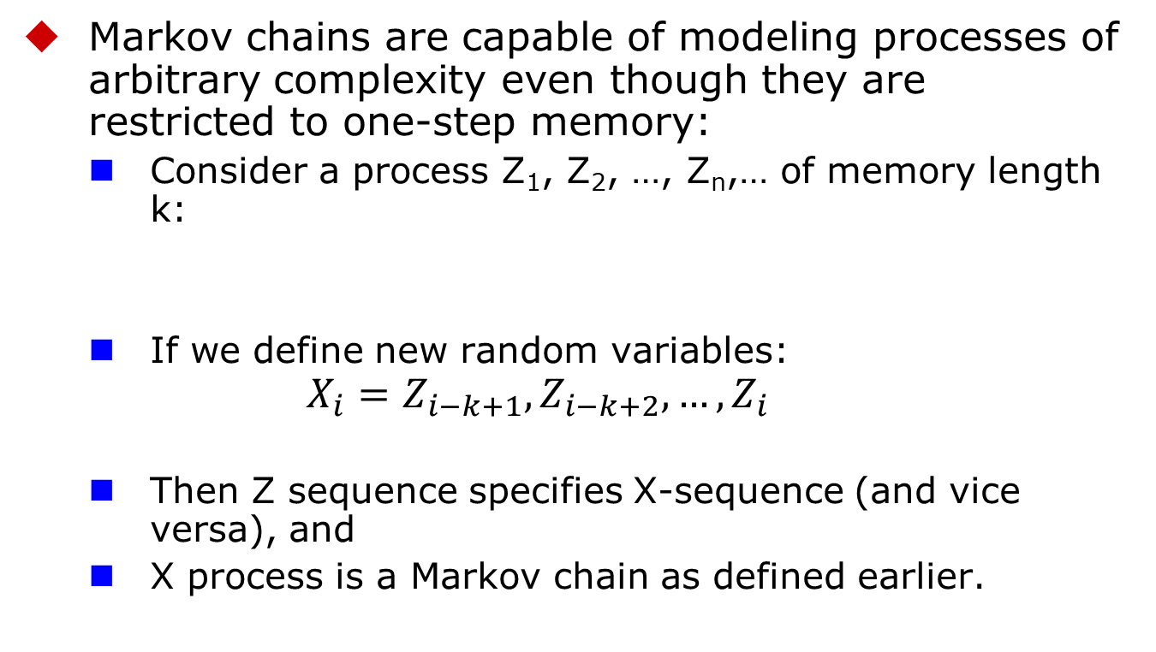
Markov Chains
Markov chains are capable of modeling processes of arbitrary complexity even though they are restricted to one-step memory:
Consider a process Z₁, Z₂, …, Z_{n},… of memory length k:
If we define new random variables:
$$X_{i}=Z_{i−k+1},Z_{i−k+2},…,Z_{i}$$
Then Z sequence specifies X-sequence (and vice versa), and
X process is a Markov chain as defined earlier.

Slide 77
Hidden Markov Model Concept
Hidden Markov Models allow more freedom to the random process while avoiding a substantial complications to the basic structure of Markov chains.
This freedom can be gained by letting the states of the chain generate observable data while hiding the said sequence itself from the observer.

Slide 78
three problems of HMM design

Slide 79
Hidden Markov Model Concept
Focus on three fundamental problems of HMM design:
The evaluation of the probability (likelihood) of a sequence of observations given a specific HMM;
The determination of a best sequence of model states;
The adjustment of model parameters so as to best account for the observed signal.

Slide 80
Discrete-Time Markov Processes Examples
Define:
A system with N distinct states S = {1,2,…,N}
Time instances associated with state changes as t=1,2,…
Actual state at time t as s_{t} (or q_{t})
State-transition probabilities as:
a_{ij} = p(s_{t}=j|s_{t-1}=i), 1≤i,j≤N
State-transition probability properties
a_{ij}
j
i

Slide 81
Discrete-Time Markov Processes Examples
Consider a simple three-state Markov Model of the weather as shown:
State 1: Precipitation (rain or snow)
State 2: Cloudy
State 3: Sunny
0.4
0.3
0.6
1
2
0.2
0.1
0.1
0.3
0.2
3
0.8

Slide 82
Discrete-Time Markov Processes Examples
Matrix of state transition probabilities:
Given the model, given in this and in the previous slide, we can now ask (and answer) several interesting questions about weather patterns over time.
0.4
0.3
0.6
1
2
0.2
0.3
0.1
0.1
0.2
3
0.8

Slide 83
Discrete-Time Markov Processes Examples
Problem 1:
What is the probability (according to the model) that the weather for eight consecutive days is
“sunny-sunny-sunny-rain-rain-sunny-cloudy-sunny”?
Solution:
Define the observation sequence, O, as:
Day 1 2 3 4 5 6 7 8
O = ( sunny, sunny, sunny, rain, rain, sunny, cloudy, sunny )
O = ( 3, 3, 3, 1, 1, 3, 2, 3 )
Want to calculate P(O|Model), the probability of observation sequence O, given the model of previous slide. Given that:

Slide 84
Discrete-Time Markov Processes Examples

Slide 85
In the previous slide the following notation was used

Slide 86
Discrete-Time Markov Processes Examples
Problem 2:
Given that the system is in a known state, what is the probability (according to the model) that it stays in that state for d consecutive days?
Solution
Day 1 2 3 d d+1
O = ( i, i, i, …, i, j≠i )
The quantity p_{i}(d) is the probability distribution function of duration d in state i. This exponential distribution is characteristic of the sate duration in Markov Chains.

Slide 87
Discrete-Time Markov Processes Examples
0.4
0.3
0.6
1
2
0.2
0.3
0.1
0.1
0.2
3
0.8
Expected number of observations (duration) in a state conditioned on starting in that state can be computed as ⇨
Thus, according to the model, the expected number of consecutive days of
Sunny weather: 1/(1-0.8)= 1/0.2=5
Cloudy weather: 1/(1-0.6)=1/0.4=2.5
Rainy weather: 1/(1-0.4)=1/0.6=1.67
Exercise Problem: Derive the above formula or directly finding mean of p_{i}(d)
Hint:

Slide 88
Illustration of Basic Concept of HMM.
Exercise 3.
Given a single fair coin, i.e., P(Heads)=P(Tails)=0.5. which you toss once and observe Tails.
What is the probability that the next 10 tosses will provide the sequence (HHTHTTHTTH)?
What is the probability that the next 10 tosses will produce the sequence (HHHHHHHHHH)?
What is the probability that 5 out of the next 10 tosses will be tails? What is the expected number of tails overt he next 10 tosses?

Slide 89
Illustration of Basic Concept of HMM.
Solution 3.
For a fair coin, with independent coin tosses, the probability of any specific observation sequence of length 10 (10 tosses) is (1/2)¹⁰ since there are 2¹⁰ such sequences and all are equally probable. Thus:
Using the same argument:

Slide 90
Illustration of Basic Concept of HMM.
Solution 3. (Continued)
Probability of 5 tails in the next 10 tosses is just the number of observation sequences with 5 tails and 5 heads (in any order) and this is:
Expected Number of tails in 10 tosses is:
Thus, on average, there will be 5H and 5T in 10 tosses, but the probability of exactly 5H and 5T is only 0.25.

Slide 91
Extensions to Hidden Markov Model
In the previous examples only Markov models were considered in which each state corresponded to a deterministically observable event.
This model is too restrictive to be applicable to many problems of interest.
Obvious extension is to have observation probabilities to be a function of the state, that is, the resulting model is doubly embedded stochastic process with an underlying stochastic process that is not directly observable (it is hidden) but can be observed only through another set of stochastic processes that produce the sequence of observations.

Slide 92
Illustration of Basic Concept of HMM.
Coin-Toss Models
Assume the following scenario: You are in a room with a barrier (e.g., a curtain) through which you cannot see what is happening.
On the other side of the barrier (e.g., a curtain) is another person who is performing a coin-tossing experiment (using one or more coins).
The person (behind the curtain) will not tell you which coin he selects at any time; he will only tell you the result of each coin flip.
Thus a sequence of hidden coin-tossing experiments is performed, with the observation sequence consisting of a series of heads and tails.

Slide 93
Coin-Toss Models
A typical observation sequence could be:
Given the above scenario, the question is:
How do we build an HMM to explain (model) the observation sequence of heads and tails?
First problem we face is deciding what the states in the model correspond to.
Second, how many states should be in the model.

Slide 94
Coin-Toss Models
One possible choice would be to assume that only a single biased coin was being tossed.
In this case, we could model the situation with a two-state model in which each state corresponds to the outcome of the previous toss (i.e., heads or tails).
P(T)=1-P(H)
P(T)=1-P(H)
1- Coin Model (Observable Markov Model)
O = H H T T H T H H T T H …
S = 1 1 2 2 1 2 1 1 2 2 1 …
P(H)
1
2
P(H)
HEADS
TAILS

Slide 95
Coin-Toss Models
Second HMM for explaining the observed sequence of con toss outcomes is given in the next slide.
In this case:
There are two states in the model, and
Each state corresponds to a different, biased coin being tossed. Each state is characterized by a probability distribution of heads and tails, and
Transitions between state are characterized by a state-transition matrix.
The physical mechanism that accounts for how state transitions are selected could itself be a set of independent coin tosses or some other probabilistic event.

Slide 96
Coin-Toss Models
1-a₁₁
a₂₂
2- Coins Model (Hidden Markov Model)
O = H H T T H T H H T T H …
S = 2 1 1 2 2 2 1 2 2 1 2 …
a₁₁
1
2
1-a₂₂
P(H) = P₁
P(T) = 1-P₁
P(H) = P₂
P(T) = 1-P₂

Slide 97
Coin-Toss Models
A third form of HMM for explaining the observed sequence of coin toss outcomes is given in the next slide.
In this case:
There are three states in the model.
Each state corresponds to using one of the three biased coins, and
Selection is based on some probabilistic event.

Slide 98
Coin-Toss Models
3- Coins Model (Hidden Markov Model)
O = H H T T H T H H T T H …
S = 3 1 2 3 3 1 1 2 3 1 3 …
a₁₂
a₂₂
a₁₁
1
2
a₂₁
a₃₁
a₃₂
a₁₃
a₂₃
3
a₃₃
 | State
Probability | 1 | 2 | 3
P(H) | P₁ | P₂ | P₃
P(T) | 1-P₁ | 1-P₂ | 1-P₃

Slide 99
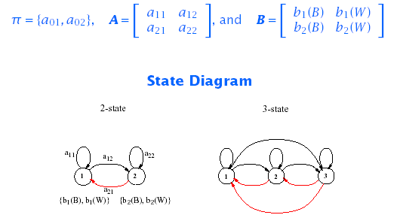
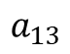
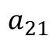
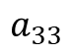
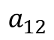
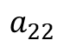
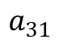
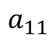
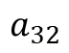
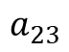
HMM: An Example
$$\begin{matrix}\left\{b_{1}\left(B\right),b_{1}\left(W\right)\right\} & \left\{b_{2}\left(B\right),b_{2}\left(W\right)\right\} & \left\{b_{3}\left(B\right),b_{3}\left(W\right)\right\}\end{matrix}$$
$$a_{11}$$
$$a_{22}$$
$$a_{13}$$
$$a_{12}$$
$$a_{23}$$
$$a_{33}$$
$$a_{21}$$
$$a_{32}$$
$$a_{31}$$

Slide 100
Coin-Toss Models
Given the choice among the three models shown for explaining the observed sequence of heads and tails, a natural question would be which model best matches the actual observations.
It should be clear that the simple one-coin model has only one unknown parameter,
The two-coin model has four unknown parameters, and
The three-coin model has nine unknown parameters.
HMM with larger number of parameters inherently has greater number of degrees of freedom and thus potentially more capable of modeling a series of coin-tossing experiments than HMM’s with smaller number of parameters.
Although this is theoretically true, practical considerations impose some strong limitations on the size of models that we can consider.

Slide 101
Coin-Toss Models
Another fundamental question here is whether the observed head-tail sequence is long and rich enough to be able to specify a complex model.
Also, it might just be the case that only a single coin is being tossed. In such a case it would be inappropriate to use three-coin model because it would be using an underspecified system.

Slide 102
The Urn-and-Ball Model
To extend the ideas of the HMM to a somewhat more complicated situation, consider the urn-and-ball system depicted in the figure (next slide).
Assume that there are N (large) brass urns in a room.
Assume that there are M distinct colors.
Within each urn there is a large quantity of colored marbles.
A physical process for obtaining observations is as follows:
A “genie” is in the room, and according to some random procedure, it chooses an initial urn.
From this urn, a ball is chosen at random, and its color is recorded as the observation.
The ball is then replaced in the urn from which it was selected.
A new urn is then selected according to the random selection procedure associated with the current urn.
Ball selection process is repeated.
This entire process generates a finite observation sequence of colors, which we would like to model as the observable output of an HMM.

Slide 103
The Urn-and-Ball Model
Simple HMM model that corresponds to the urn-and-ball process is one in which:
Each state corresponds to a specific urn, and
For which a (marble) color probability is defined for each state.
The choice of state is dictated by the state-transition matrix of the HMM.
It should be noted that the color of the marble in each urn may be the same, and the distinction among various urns is in the way the collection of colored marbles is composed.
Therefore, an isolated observation of a particular color ball does not immediately tell which urn it is drawn from.

Slide 104
The Urn-and-Ball Model
…
An N-State urn-and-ball model illustrating the general case of a discrete symbol HMM
O = {GREEN, GREEN, BLUE, RED, YELLOW, …, BLUE}
URN 1 | URN 2 | URN N
P(RED)=b₁(1) | P(RED)=b₂(1) | P(RED)=b_{N}(1)
P(BLUE)=b₁(2) | P(BLUE)=b₂(2) | P(BLUE)=b_{N}(2)
P(GREEN)=b₁(3) | P(GREEN)=b₂(3) | P(GREEN)=b_{N}(3)
P(YELLOW)=b₁(4) | P(YELLOW)=b₂(4) | P(YELLOW)=b_{N}(4)
… | … | …
P(ORANGE)=b₁(M) | P(ORANGE)=b₂(M) | P(ORANGE)=b_{N}(M)

Slide 105
Elements of a Discrete HMM
N : number of states in the model
states s = {s₁,s₂,...,s_{N}}
state at time t, q_{t} ∈ s
M: number of (distinct) observation symbols (i.e., discrete observations) per state
observation symbols, v = {v₁,v₂,...,v_{M} }
observation at time t, o_{t} ∈ v
A = {a_{ij}} : state transition probability distribution
a_{ij} = P(q_{t+1}=s_{j}|q_{t}=s_{i}), 1 ≤ i,j ≤ N
B = {bj} : observation symbol probability distribution in state j
b_{j}(k) = P(v_{k} at t|q_{t}=sj ), 1 ≤ j ≤ N, 1 ≤ k ≤ M
π = {π_{i}}: initial state distribution
π_{i} = P(q₁=s_{i} )1 ≤ i ≤ N
HMM is typically written as: λ = {A, B, π}
This notation also defines/includes the probability measure for O, i.e., P(O|λ)

Slide 106
HMM Generator of Observations
Given appropriate values of N, M, A, B, and π, the HMM can be used as a generator to give an observation sequence:
Each observation o_{t} is one of the symbols from V, and T is the number of observation in the sequence.

Slide 107
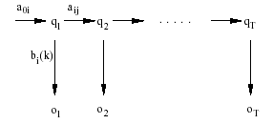
HMM Generator of Observations
The algorithm:
Choose an initial state q₁=s_{i} according to the initial state distribution π.
For t=1 to T:
Choose o_{t}=v_{k} according to the symbol probability distribution in state s_{i}, i.e., b_{i}(k).
Transit to a new state q_{t+1} = s_{j} according the state-transition probability distribution for state s_{i}, i.e., a_{ij}.
Increment t, t=t+1; return to step 2 if t<T; otherwise, terminate the procedure.

Slide 108
Three Basic HMM Problems
Scoring: Given an observation sequence O={o₁,o₂,...,o_{T}} and a model λ = {A, B,π}, how do we compute P(O| λ), the probability of the observation sequence?
⇒ The Probability Evaluation (Forward & Backward Procedure)
Matching: Given an observation sequence O={o₁,o₂,...,o_{T}} how do we choose a state sequence: Q={q₁,q₂,...,q_{T}} which is optimum in some sense?
⇒ The Viterbi Algorithm
Training: How do we adjust the model parameters λ = {A,B, π} to maximize P(O| λ)?
⇒ The Baum-Welch Re-estimation

Slide 109
Three Basic HMM Problems
Problem 1 - Scoring:
Is the evaluation problem; namely, given a model and a sequence of observations, how do we compute the probability that the observed sequence was produced by the model?
It can also be views as the problem of scoring how well a given model matches a given observation sequence.
The later viewpoint is extremely useful in cases in which we are trying to choose among several competing models. The solution to Problem 1 allows us to choose the model that best matches the observations.

Slide 110
Three Basic HMM Problems
Problem 2 - Optimal State Sequence:
Is the one in which we attempt to uncover the hidden part of the model – that is to find the “correct” state sequence.
It must be noted that for all but the case of degenerate models, there is no “correct” state sequence to be found. Hence, in practice one can only find an optimal state sequence based on chosen optimality criterion.
Several reasonable optimality criteria can be imposed and thus the choice of criterion is a strong function of the intended use.
Typical uses are:
Learn about the structure of the model
Find optimal state sequences for continues speech recognition.
Get average statistics of individual states, etc.

Slide 111
Three Basic HMM Problems
Problem 3 – Training:
Attempts to optimize the model parameters to best describe how a given observation sequence comes about.
The observation sequence used to adjust the model parameters is called a training sequence because it is used to “train” the HMM.
Training algorithm is the crucial one since it allows to optimally adapt model parameters to observed training data to create best HMM models for real phenomena.

Slide 112
Simple Isolated-Word Speech Recognition
For each word of a W word vocabulary design separate N-state HMM.
Speech signal of a given word is represented as a time sequence of coded spectral vectors (How?).
There are M unique spectral vectors; hence each observation is the index of the spectral vector closest (in some spectral distortion sense) to the original speech signal. (e.g., Vector Quantization)
For each vocabulary word, we have a training sequence consisting of a number of repetitions of sequences of codebook indices of the word (by one ore more speakers).

Slide 113
Simple Isolated-Word Speech Recognition
First task is to build individual word models.
Use solution to Problem 3 to optimally estimate model parameters for each word model.
To develop an understanding of the physical meaning of the model states:
Use the solution to Problem 2 to segment each word training sequences into states
Study the properties of the spectral vectors that led to the observations occurring in each state.
Goal is to make refinements of the model:
More states,
Different Codebook size, etc.
Improve and optimize the model
Once the set of W HMM’s has been designed and optimized, recognition of an unknown word is performed using the solution to Problem 1 to score each word model based upon the given test observation sequence, and select the word whose model score is highest (i.e., the highest likelihood).

Slide 114
Problem 1: Scoring
Computation of P(O | λ)

Slide 115
Computation of P(O|λ)
Solution to Problem 1:
Wish to calculate the probability of the observation sequence, O={o₁,o₂,...,o_{T}} given the model λ.
The most straight forward way is through enumeration of every possible state sequence of length T (the number of observations). Thus there are N^{T} such state sequences:
Where:

Slide 116
Computation of P(O|λ)
Consider the fixed state sequence: Q= q₁q₂ ...q_{T}
The probability of the observation sequence O given the state sequence, assuming statistical independence of observations, is:
Thus:
The probability of such a state sequence q can be written as:

Slide 117
Computation of P(O|λ)
The joint probability of O and Q, i.e., the probability that O and Q occur simultaneously, is simply the product of the previous terms:
The probability of O given the model λ is obtained by summing this joint probability over all possible state sequences Q:

Slide 118
Computation of P(O|λ)
Interpretation of the previous expression:
Initially at time t=1 we are in state q₁ with probability π_{q1}, and generate the symbol o₁ (in this state) with probability b_{q1}(o₁).
In the next time instance t=t+1 (t=2) transition is made to state q₂ from state q₁ with probability a_{q1q2} and generate the symbol o₂ with probability b_{q2}(o₂).
Process is repeated until the last transition is made at time T from state q_{T} from state q_{T-1} with probability a_{qT-1qT} and generate the symbol o_{T} with probability b_{qT}(o_{T}).
Practical Problem:
Calculation required ≈ 2T · N^{T} (there are N^{T} such sequences)
For example: N =5 (states),T = 100 (observations) ⇒ 2 · 100 · 5¹⁰⁰ = 10⁷² computations!
More efficient procedure is required ⇒ Forward Algorithm

Slide 119
The Forward Algorithm
Let us define the forward variable, α_{t}(i), as the probability of the partial observation sequence up to time t and state s_{i} at time t, given the model, i.e.
It can easily be shown that:
Thus the algorithm:

Slide 120
The Forward Algorithm
Initialization
Induction
Termination
t
t+1
s₁
s₂
a_{1j}
a_{2j}
s₃
a_{3j}
s_{j}
a_{Nj}
s_{N}
α_{t}(i)
α_{t+1}(j)

Slide 121
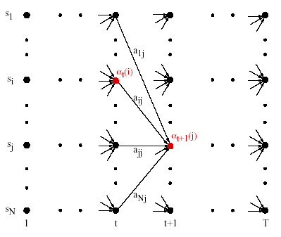
The Forward Algorithm

Slide 122
The Backward Algorithm
Similarly, let us define the backward variable, β_{t}(i), as the probability of the partial observation sequence from time t+1 to the end, given state s_{i} at time t and the model, i.e.
It can easily be shown that:
By induction the following algorithm is obtained:

Slide 123
The Backward Algorithm
Initialization
Induction
Termination
t
t+1
s₁
a_{i1}
a_{i2}
s₂
s_{i}
a_{i3}
s₃
a_{iN}
s_{N}
β_{t}(i)
β_{t+1}(j)

Slide 124
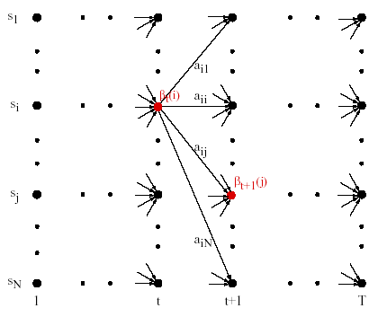
The Backward Algorithm

Slide 125
Problem 2: Matching
Finding Optimal State Sequences

Slide 126
Finding Optimal State Sequences
One criterion chooses states, q_{t}, which are individually most likely
This maximizes the expected number of correct states
Let us define γ_{t}(i) as the probability of being in state s_{i} at time t, given the observation sequence and the model, i.e.
Then the individually most likely state, q_{t}, at time t is:

Slide 127
Finding Optimal State Sequences
Note that it can be shown that:
The individual optimality criterion has the problem that the optimum state sequence may not obey state transition constraints
Another optimality criterion is to choose the state sequence which maximizes P(Q ,O|λ).
This can be found by the Viterbi algorithm

Slide 128
The Viterbi Algorithm
Let us define δ_{t}(i) as the highest probability along a single path, at time t, which accounts for the first t observations, i.e.
By induction:
To retrieve the state sequence, we must keep track of the state sequence which gave the best path, at time t, to state s_{i}
We do this in a separate array ψ_{t}(i).

Slide 129
The Viterbi Algorithm
Initialization:
Recursion
Termination

Slide 130
The Viterbi Algorithm
Path (state-sequence) backtracking:
Computation Order: ≈N²T

Slide 131
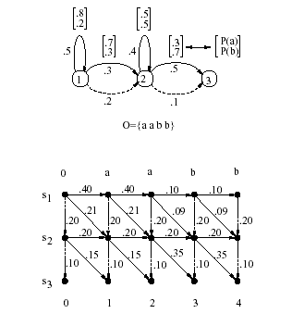
The Viterbi Algorithm Example
0.5*0.8
0.5*0.2
0.3*0.7
0.3*0.7
0.2*1
0.2*1
0.4*0.5
0.4*0.5
0.5*0.7
0.1*1
0.1*1

Slide 132
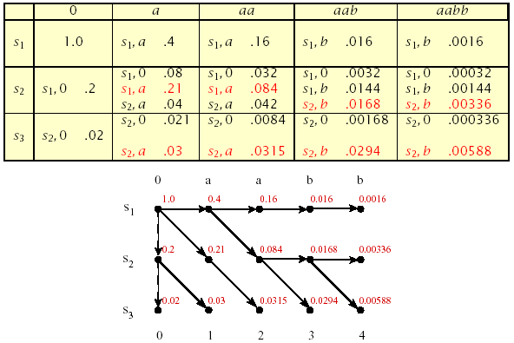
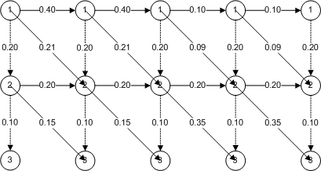
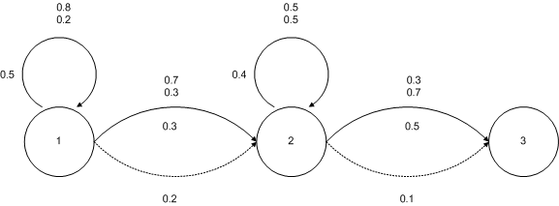
The Viterbi Algorithm: An Example (cont’d)

Slide 133
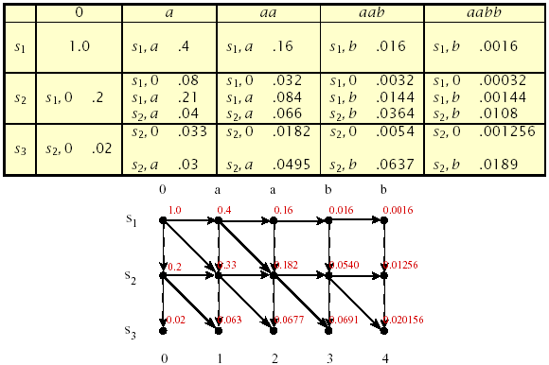
Matching Using Forward-Backward Algorithm

Slide 134
Training
HMM Training: Baum-Welch Re-estimation

Slide 135
Solution to Problem 3: Baum-Welch Re-estimation
Baum-Welch re-estimation uses EM to determine ML parameters
Define ξ_{t}(i,j) as the probability of being in state s_{i} at time t and state s_{j} at time t+1, given the model and observation sequence
Then, from the definitions of the forward and backward variables, can write ξ_{t}(i,j) in the form:

Slide 136
Solution to Problem 3: Baum-Welch Re-estimation
Hence considering that we have defined γ_{t}(i) as the probability of being in state s_{i} at time t, we can relate γ_{t}(i) to ξ_{t}(i,j) by summing over j:

Slide 137
Solution to Problem 3: Baum-Welch Re-estimation
Summing over γ_{t}(i) and ξ_{t}(i,j), we get

Slide 138
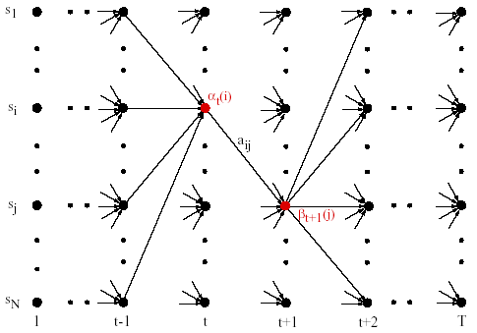
Baum-Welch Re-estimation Procedures

Slide 139
Baum-Welch Re-estimation Formulas

Slide 140
Baum-Welch Re-estimation Formulas
If λ =(A , B, π).is the initial model, and re-estimated model. Then it can be proved that either:
The initial model, λ, defines a critical point of the likelihood function, in which case λ = λ, or
Model λ is more likely than λ in the sense that P(O|λ)>P(O|λ), i.e., we have found a new model λ from which the observation sequence is more likely to have been produced.
Thus we can improve the probability of O being observed from the model if we iteratively use λ in place of λ and repeat the re-estimation until some limiting point is reached. The resulting model is called the maximum likelihood HMM.
-
-
-
-
-

Slide 141
Multiple Observation Sequences

Slide 142
Multiple Observation Sequences
Speech recognition typically uses left-to-right HMMs. These HMMs can not be trained using a single observation sequence, because only a small number of observations are available to train each state. To obtain reliable estimates of model parameters, one must use multiple observation sequences. In this case, the re-estimation procedure needs to be modified.
Let us denote the set of K observation sequences as
O = {O⁽¹⁾, O⁽²⁾, …, O^{(K)}}
Where O^{(k)} = {O₁^{(k)}, O₂^{(k)}, …, O_{Tk}^{(k)}} is the k-th observation sequence.

Slide 143
Multiple Observation Sequences
Assume that the observations sequences are mutually independent, we want to estimate the parameters so as to maximize
Since the re-estimation formulas are based on frequency of occurrence of various events, we can modify them by adding up the individual frequencies of occurrence for each sequence. The modified re-estimation formulas for ā_{ij} and b_{j}(l) are:
_

Slide 144
Multiple Observation Sequences

Slide 145
Multiple Observation Sequences
Note: π_{i} is not re-estimated since:
π₁ = 1 and
π_{i} = 0, i≠1.

Slide 146
Another View of Training

Slide 147
Training Problem
How to compute the mean and the variance of the Gaussian for each HMM state q_{i}?
Completely labeled training set:
Each acoustic observation is labeled with the HMM state that produced it.

Slide 148
TIMIT Labeled Utterance

Slide 149
Training Problem
With such a training set we could compute the mean of each sate by just taking the average of the values for each o_{t} that corresponds to state i as shown in equations below:

Slide 150
Training Problem
But since states are hidden in an HMM, we don’t know exactly which observation vector o_{t} was produced by which state.
Would like to do is to assign each observation vector o_{t} to every possible state i, prorated by the probability that the HMM was in state i at time t.
We already know how to do this prorating; the probability of being in state i at time t, defined as γ_{t}(i), computation of which is specified by Baum-Welch algorithm using the forward and backward probabilities. (Baum-Welch, an iterative algorithm)
We need to do the probability computation of γ_{t}(i) iteratively since getting a better observation probability b will also help us be more sure of the probability γ of being in a state at a certain time.
Thus we give equations for computing an updated mean and variance:

Slide 151
Update of Means and Variance

Slide 152
Baum-Welch Forward-Backward Algorithm for γ_{t}(i)
Equations presented in previous slide are then used in the forward-backward (Baum-Welch) training of the HMM.
As we will see, the values of μ_{j} and variance σ_{j}² are first set to some initial estimate, which is then re-estimated until the numbers converge

Slide 153
Probability of an Observation Sequence P(O|λ)
Recursive computation of the Probability of the observation sequence:
Define:
A system with N distinct states Q = {q₁,q₂,…,q_{N}}
Time instances associated with state changes as t=1,2,…
Actual state at time t as q_{t}
State-transition probabilities as:
a_{ij} = p(q_{t}=j|q_{t-i}=i), 1≤i,j≤N
State-transition probability properties
a_{ij}
j
i

Slide 154
Computation of P(O|λ)
Wish to calculate the probability of the observation sequence, O={o₁,o₂,...,o_{T}} given the model λ.
The most straight forward way is through enumeration of every possible state sequence of length T (the number of observations). Thus there are N^{T} such state sequences:
Where:

Slide 155
Computation of P(O|λ)
Consider the fixed state sequence: Q= q₁q₂ ...q_{T}
The probability of the observation sequence O given the state sequence, assuming statistical independence of observations, is:
Thus:
The probability of such a state sequence Q can be written as:

Slide 156
Computation of P(O|λ)
The joint probability of O and Q, i.e., the probability that O and Q occur simultaneously, is simply the product of the previous terms:
The probability of O given the model λ is obtained by summing this joint probability over all possible state sequences Q :

Slide 157
Computation of P(O|λ)
Interpretation of the previous expression:
Initially at time t=1 we are in state q₁ with probability π_{q1}, and generate the symbol o₁ (in this state) with probability b_{q1}(o₁).
In the next time instance t=t+1 (t=2) transition is made to state q₂ from state q₁ with probability a_{q1q2} and generate the symbol o₂ with probability b_{q2}(o₂).
Process is repeated until the last transition is made at time T from state q_{T} from state q_{T-1} with probability a_{qT-1qT} and generate the symbol o_{T} with probability b_{qT}(o_{T}).

Slide 158
Computation of P(O|λ)
Practical Problem:
Calculation required ≈ 2T · N^{T} (there are N^{T} such sequences)
For example: N =5 (states),T = 100 (observations) ⇒ 2 · 100 · 5¹⁰⁰ = 10⁷² computations!
More efficient procedure is required ⇒ Forward Algorithm

Slide 159
The Forward Algorithm
Let us define the forward variable, α_{t}(i), as the probability of the partial observation sequence up to time t and state s_{i} at time t, given the model λ, i.e.
It can be easily shown that:
Thus the algorithm:

Slide 160
The Forward Algorithm
Initialization
Induction
Termination
t
t+1
s₁
s₂
a_{1j}
a_{2j}
s₃
a_{3j}
s_{j}
a_{Nj}
s_{N}
α_{t}(i)
α_{t+1}(j)

Slide 161
The Forward Algorithm

Slide 162
The Backward Algorithm
Initialization
Induction
Termination
t
t+1
s₁
a_{i1}
a_{i2}
s₂
s_{i}
a_{i3}
s₃
a_{iN}
s_{N}
β_{t}(i)
β_{t+1}(j)

Slide 163
The Backward Algorithm

Slide 164
Finding Optimal State Sequences
One criterion chooses states, q_{t}, which are individually most likely
This maximizes the expected number of correct states
Let us define γ_{t}(i) as the probability of being in state s_{i} at time t, given the observation sequence and the model, i.e.
Then the individually most likely state, q_{t}, at time t is:

Slide 165
Finding Optimal State Sequences
Note that it can be shown that:
The individual optimality criterion has the problem that the optimum state sequence may not obey state transition constraints
Another optimality criterion is to choose the state sequence which maximizes P(Q ,O|λ);
This can be found by the Viterbi algorithm

Slide 166
The Viterbi Algorithm
Let us define δ_{t}(i) as the highest probability along a single path, at time t, which accounts for the first t observations, i.e.
By induction:
To retrieve the state sequence, we must keep track of the state sequence which gave the best path, at time t, to state s_{i}
We do this in a separate array ψ_{t}(i).

Slide 167
The Viterbi Algorithm
Initialization:
Recursion
Termination

Slide 168
The Viterbi Algorithm
Path (state-sequence) backtracking:
Computation Order: ≈N²T

Slide 169
Trellis
Example of HMM with output symbols associated with transitions
Offers easy way to calculate probability:
Trellis of two different stages for outputs 0 and 1
o=0
1
1
1
1
0
3
2
2
0
0
1
1
1
3
3
2
o=1
0
1
1
2
2
3
3

Slide 170
Trellis of the sequence 0110
1
0
3
1
0
0
1
1
1
0
2
1
1
1
1
1
2
2
2
2
2
3
3
3
3
3
o=0
o=1
o=1
o=0
s₀
1
1
1
1
1
2
2
2
2
2
3
3
3
3
3
t=1
t=2
t=2
t=3
t=4

Slide 171
Multivariate Gaussians
Equation in slide Output Probability of an Observation shows how to use a Gaussian to compute an acoustic likelihood for a single cepstral feature. Since an acoustic observation is a vector of D (39) features, we’ll need to use a multivariate Gaussian, which allows us to assign a probability to a D (39)-valued vector.
Where a univariate Gaussian is defined by a mean μ and variance σ², a multivariate Gaussian is defined by a mean vector μ of dimensionality D and a covariance matrix Σ, defined below. As we discussed in the previous section, for a typical cepstral feature vector in LVCSR, D is 39.

Slide 172
Multivariate Gaussians
Thus for a given HMM state j with mean vector μ_{j} of dimensionality D and a covariance matrix Σ_{j}, and a given observation vector o_{t}, the multivariate Gaussian probability estimate is.
Covariance matrix Σ_{j} is the variance between each pair of feature dimensions.
It turns out that keeping a separate variance for each dimension is equivalent to having a covariance matrix that is diagonal, i.e.
non-zero elements only appear along the main diagonal of the matrix. The main diagonal of such a diagonal covariance matrix contains the variances of each dimension, σ₁², σ ₂² , ... σ_{D}².

Slide 173
2D Gaussian PDF’s

Slide 175
Diagonal vs Full Covariance Matrixes
A Gaussian with a full covariance matrix is thus a more powerful model of acoustic likelihood than one with a diagonal covariance matrix. And indeed, speech recognition performance is better using full-covariance Gaussians than diagonal-covariance Gaussians.
But there are two problems with full-covariance Gaussians that makes them difficult to use in practice.
First, they are slow to compute. A full covariance matrix has D² parameters, where a diagonal covariance matrix has only D. This turns out to make a large difference in speed in real ASR systems.
Second, a full covariance matrix has many more parameters and hence requires much more data to train than a diagonal covariance matrix. Using a diagonal covariance model means we can save room for using our parameters for other things like triphones (context-dependent phones).
For this reason, in practice most ASR systems use diagonal covariance. We will assume diagonal covariance for the remainder of this section.

Slide 176
Diagonal Covariance Matrix
General equation of output probability function of slide Output Probability of an Observation can thus be simplified to the version presented here:
Clearly, training of multivariate Gaussian is a simple generalization of univariate Gaussians. The same Baum-Welch training is used where the value of x_{t}(i) to tell us the likelihood of being in state i at time t. Namely:

Slide 177
Gaussian Mixture Models
The previous subsection showed that we can use a multivariate Gaussian model to assign a likelihood score to an acoustic feature vector observation. This models each dimension of the feature vector as a normal distribution.
But a particular cepstral feature might have a very non-normal distribution; the assumption of a normal distribution may be too strong an assumption.
For this reason, we often model the observation likelihood not with a single multivariate Gaussian, but with a weighted mixture of multivariate Gaussians. Such a model is called a Gaussian Mixture Model or GMM

Slide 178
Arbitrary Function Approximated with GMM’s

Slide 179
Gaussian Mixture Model and Estimation Maximization
Training GMM’s
How can we train a GMM model if we do not know in advance which mixture is supposed to account for which part of each distribution?
Baum-Welch algorithm provides the likelihood of being in each state j at time t.
Similarly, one can use Baum-Welch algorithm to provide us with the probability of a certain mixture accounting for the observation.

Slide 180
Estimation Maximization for GMM Computation
γ_{tm}(j) – probability of being in state j at time t with the mth mixture component accounting for the output observation o_{t}.
We can use γ_{tm}(j) to re-compute the mean, mixture weight, and covariance using the following equations:

Slide 181
Estimation Maximization for GMM Computation

Slide 182
1-D Examples of GMM’s
1-D training sequence with one Gaussian mixture

Slide 183
1-D training sequence with two Gaussian mixtures

Slide 184
Number of Mixtures
300 points, 1 mixture
300 points, 3 mixtures

Slide 185
Number of Mixtures
300 points, 5 mixture
300 points, 10 mixtures

Slide 186
Number of Mixtures
900 points, 1 mixture
900 points, 3 mixtures

Slide 187
Number of Mixtures
900 points, 5 mixture
900 points, 10 mixtures

Slide 188
Number of Mixtures
log average observation probability for the 10 models in the short sequence and long sequence experiments respectively

Slide 189
Search and Decoding
Search and Decoding in Speech Recogntion

Slide 190
Search and Decoding
Search and Decoding is the last part of a complete speech recognizer and central subject of this class.
Previously it has been shown how to
Extract cepstral features for a frame, and how to
Compute the acoustic likelihood b_{j}(o_{t}) for that frame.
We also know how to represent lexical knowledge, that
Each word HMM is composed of a sequence of phone models, and
Each phone model of a set of subphone states.
Finally, in N-gram language modeling we showed how to use N-grams to build a model of word predictability.
In this section we show how to combine all of this knowledge to solve the problem of decoding: combining all these probability estimators to produce the most probable string of words.

Slide 191
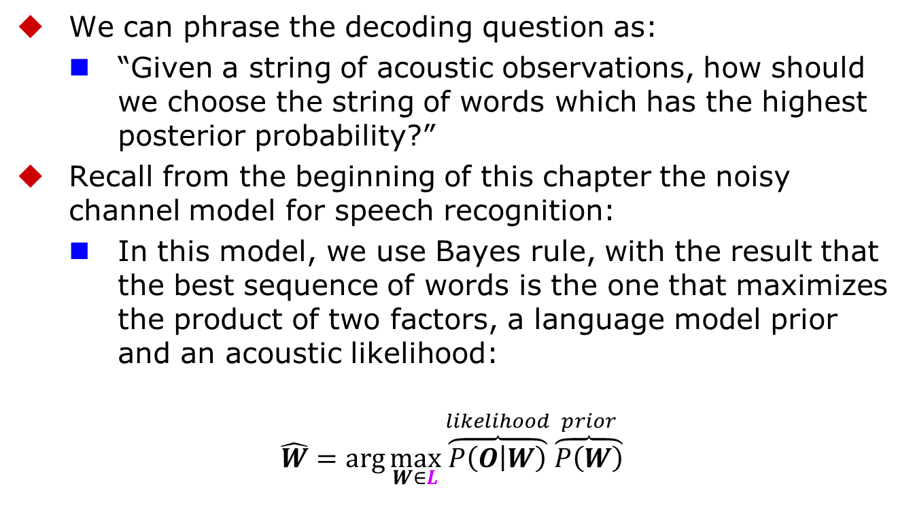
Search and Decoding
We can phrase the decoding question as:
“Given a string of acoustic observations, how should we choose the string of words which has the highest posterior probability?”
Recall from the beginning of this chapter the noisy channel model for speech recognition:
In this model, we use Bayes rule, with the result that the best sequence of words is the one that maximizes the product of two factors, a language model prior and an acoustic likelihood:
$$\hat{W}=\arg{\max_{W∈L}}{\overset{likelihood}{\overbrace{P\left(O | W\right)}}}\overset{prior}{\overbrace{P\left(W\right)}}$$

Slide 192
Search and Decoding
Incorrect Independence Assumption:
Before showing how to combine acoustic model scoring with language model scoring we will need to modify the equation in the previous slide because it relies on some incorrect independence assumptions.
Recall that a multivariate Gaussian mixture classifier can be trained to compute the likelihood of a particular acoustic observation (a frame) given a particular state (subphone).
By computing separate classifiers for each acoustic frame and multiplying these probabilities to get the probability of the whole word, we are severely underestimating the probability of each subphone.
This is because there is a lot of continuity across frames; if we were to take into account the acoustic context, we would have a greater expectation for a given frame and hence could assign it a higher probability.

Slide 193
Search and Decoding
We must therefore reweight the two probabilities.
We do this by adding in
A language model scaling factor or LMSF, also called the language weight. This factor is an exponent on the language model probability P(W).
Because P(W) is less than one and the LMSF is greater than one (between 5 and 15, in many systems), this has the effect of decreasing the value of the LM probability

Slide 194
Word Insertion Problem
Word Insertion Problem:
Re-weighting the language model probability P(W) in this way requires us to make one more change. This is because P(W) has a side-effect as a penalty for inserting words.
Clarification:
It’s simplest to see this in the case of a uniform language model, where every word in a vocabulary of size |V| has an equal probability 1/|V|.
In this case, a sentence with N words will have a language model probability of 1/|V| for each of the N words, for a total penalty of N/|V|. The larger N is (the more words in the sentence), the more times this 1/V penalty multiplier is taken, and the less probable the sentence will be.
Thus if (on average) the language model probability decreases (causing a larger penalty), the decoder will prefer fewer, longer words.
If the language model probability increases (larger penalty), the decoder will prefer more shorter words. Thus our use of a LMSF to balance the acoustic model has the side-effect of decreasing the word insertion penalty.

Slide 195
Word Insertion Problem
To offset this, we need to add back in a separate word insertion penalty (WIP):
In practice logprobs are used, thus the goal of the decoder is find the solution that maximises the following expression:

Slide 196
Decoding and Search
Since we have defined the equation that must be maximized, the problem of how to do it: that is decoding problem, must be now addressed.
Definition:
It is the problem of the decoder to simultaneously
segment the utterance into words, and
identify each of the words
Difficulty
This task is made difficult by variation, both in terms of 1) how words are pronounced in terms of phones, and 2) how phones are articulated in acoustic features.
Just to give an intuition of the difficulty of the problem imagine a massively simplified version of the speech recognition task, in which the decoder is given a series of discrete phones. In such a case, we would know what each phone was with perfect accuracy, and yet decoding is still difficult.

Slide 197
Decoding and Search
For example, try to decode the following sentence from the (hand-labeled) sequence of phones from the Switchboard corpus:
[ay d ih s hh er d s ah m th ih ng ax b aw m uh v ih ng r ih s en l ih]
The task is hard partly because of
Coarticulation:
coarticulation and fast speech (e.g., [d] for the first phone of just!). But it’s also hard because
No Word Boundaries:
speech, unlike English writing, has no spaces indicating word boundaries.
The true decoding task, in which we have to identify the phones at the same time as we identify and segment the words, is of course much harder.
Notes:
I just heard something about moving recently

Slide 198
“I just heard something about moving recently”

Slide 199
Digit Recognition Example

Slide 200
Notation
N: number of states in the model
Set of states Q = {q₁,q₂,...,q_{N}}
state at time t, q_{t} ∈ Q
A = {a_{ij}}: state transition probability distribution matrix
a_{ij} = P(Q_{t+1}=q_{j}|Q_{t}=q_{i}), 1 ≤ i,j ≤ N
B = {b_{j}(o_{t})}: A set of observation symbol probability distribution also called emission probabilities
b_{j}(o_{t}) = P(o_{t}|q_{j} ), 1 ≤ j ≤ N
π = {π_{i}}: initial state distribution
π_{i} = P(q_{i}) 1 ≤ i ≤ N
A special start and end state which are not associated with observations.
q₀, q_{e}

Slide 201
Search and Deconding
For decoding, we will start with the Viterbi algorithm, applied in the domain of digit recognition, a simple task with a vocabulary size of 11 (the numbers “one” through “nine” plus “zero” and “oh”).
Specifically:
Q = q₁q₂ . . .q_{N} | a set of states corresponding to subphone.
A = a₀₁a₀₂ ...a_{n1}...a_{nn} | a transition probability matrix A, each a_{ij} representing the probability for each subphone of taking a self-loop or going to the next subphone. Together, Q and A implement a pronunciation lexicon, an HMM state graph structure for each word that the system is capable of recognizing.
B = b_{i}(o_{t} ) | A set of observation likelihoods:, also called emission probabilities, each expressing the probability of a cepstral feature vector (observation ot ) being generated from subphone state i.

Slide 202
Search & Decoding
The HMM structure for each word comes from a lexicon of word pronunciations.
Generally we use an off-the-shelf pronunciation dictionary such as the free CMUdict dictionary.
Recall from the slide Phone Modeling with HMMs that the HMM structure for words in speech recognition is a simple concatenation of phone HMMs, each phone consisting of 3 sub-phone states, where every state has exactly two transitions: a self-loop and a loop to the next phone.
Thus the HMM structure for each digit word in our digit recognizer is computed simply by taking the phone string from the dictionary, expanding each phone into 3 sub-phones, and concatenating together.
In addition, we generally add an optional silence phone at the end of each word, allowing the possibility of pausing between words. We usually define the set of states Q from some version of the ARPAbet, augmented with silence phones, and expanded to create three sub-phones for each phone.

Slide 203
Search & Decoding
The A and B matrices for the HMM are trained by the Baum-Welch algorithm in the embedded training procedure that we will describe in one of following sections. For now we’ll assume that these probabilities have been trained.
Fig. in the next slide shows the resulting HMM for digit recognition.
Note that we’ve added non-emitting start and end states, with transitions from the end of each word to the end state, and a transition from the end state back to the start state to allow for sequences of digits.
Note also the optional silence phones at the end of each word.

Slide 204
Digit Recognition with HMM’s

Slide 205
Digit Recognition with HMM’s

Slide 206
Viterbi Search
Now that we have an HMM, we can use the same forward and Viterbi algorithms that we introduced previously.
Let’s see how to use the forward algorithm to generate P(O|W), the likelihood of an observation sequence O given a sequence of words W; we’ll use the single word “five”.
In order to compute this likelihood, we need to sum over all possible sequences of states; assuming five has the states [f], [ay], and [v], a 10-observation sequence includes many sequences such as the following:
f ay ay ay ay v v v v v
f f ay ay ay ay v v v v
f f f f ay ay ay ay v v
f f ay ay ay ay ay ay v v
f f ay ay ay ay ay ay ay v
f f ay ay ay ay ay v v v
...

Slide 207
Forward Algorithm For Sequence Matching
The forward algorithm efficiently sums over this large number of sequences in O(N²T) time.
Let’s quickly review the forward algorithm. It is a dynamic programming algorithm, i.e. an algorithm that uses a table to store intermediate values as it builds up the probability of the observation sequence.
The forward algorithm computes the observation probability by summing over the probabilities of all possible paths that could generate the observation sequence.
Each cell of the forward algorithm trellis at α_{t}(j) or forward[t, j] represents the probability of being in state j after seeing the first t observations, given the automaton (model) λ . The value of each cell at α_{t}(j) is computed by summing over the probabilities of every path that could lead us to this cell. Formally, each cell expresses the following probability:

Slide 208
Forward Algorithm

Slide 209
The Forward Algorithm
Initialization
Induction
Termination
t
t+1
s₁
s₂
a_{1j}
a_{2j}
s₃
a_{3j}
s_{j}
a_{Nj}
s_{N}
α_{t}(i)
α_{t+1}(j)

Slide 210
Example of Forward Trellis for word “five”

Slide 211
Viterbi Trellis
Each cell of the Viterbi trellis, v_{t}(j) represents the probability that the HMM is in state j after seeing the first t observations and passing through the most likely state sequence q₁...q_{t−1}, given the automaton/model λ.
The value of each cell v_{t}( j) is computed by recursively taking the most probable path that could lead us to this cell. Formally, each cell expresses the following probability:
Like other dynamic programming algorithms, Viterbi fills each cell recursively. Given that we had already computed the probability of being in every state at time t−1,We compute the Viterbi probability by taking the most probable of the extensions of the paths that lead to the current cell. For a given state q_{j} at time t, the value v_{t}(j) is computed as follows:

Slide 212
Viterbi Alignment
The three factors that are multiplied in equation above for extending the previous paths to compute the Viterbi probability at time t are:
v_{t−1}(i) the previous Viterbi path probability from the previous time step
a_{ij} the transition probability from previous state q_{i} to current state q_{j}
b_{j}(o_{t}) the state observation likelihood of the observation symbol o_{t} given the current state j

Slide 213
Viterbi Alignment
Recall that the goal of the Viterbi algorithm is to find the best state sequence q = (q₁q₂q₃ . . .q_{T}) given the set of observations o = (o₁o₂o₃ . . .o_{T} ).
It needs to also find the probability of this state sequence.
Note that the Viterbi algorithm is identical to the forward algorithm except that it takes the MAX over the previous path probabilities where forward takes the SUM.
Fig. in the next slide shows the computation of the first three time-steps in the Viterbi trellis corresponding to the forward trellis in Example of Forward Trellis for word “five”.
We have again used the made-up probabilities for the cepstral observations; here we also follow common convention in not showing the zero cells in the upper left corner. Note that only the middle cell in the third column differs from Viterbi to forward algorithm.

Slide 214
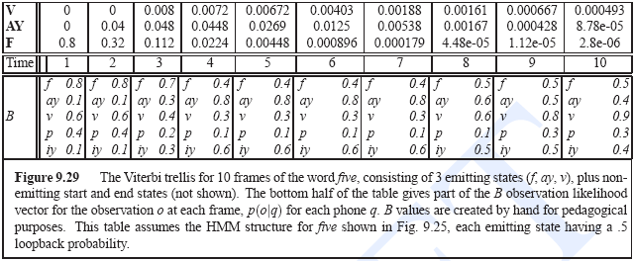
Example of Viterbi Trellis for word “five”

Slide 215
Viterbi vs. Forward/Baum Welch Algorithm
The forward algorithm gives the probability of the observation sequence as .00128, which we get by summing the final column.
The Viterbi algorithm gives the probability of the observation sequence given the best path, which we get from the Viterbi matrix as .000493.
The Viterbi probability is much smaller than the forward probability, as we should expect since Viterbi comes from a single path, where the forward probability is the sum over all paths.

Slide 216
Viterbi Decoder
The real usefulness of the Viterbi/Forward (Baum Welch) decoder, of course, lies in its ability to decode a string of words.
In order to do cross-word decoding, we need to augment the A matrix, which only has intra-word state transitions, with the inter-word probability of transitioning from the end of one word to the beginning of another word.
The digit HMM model in Digit Recognition with HMM’s showed that we could just treat each word as independent, and use only the unigram probability.
Higher-order N-grams are much more common. Fig. in the next slide, for example, shows an augmentation of the digit HMM with bigram probabilities.

Slide 217
Modified Digit Network with Bigram Grammar

Slide 218
Multi-Word Decoding Trellis
A schematic of the HMM trellis for such a multi-word decoding task is shown in Fig. of next slide.
Between words (inter-word) transitions are added.
The transition probability on this arc, rather than coming from the A matrix inside each word, comes from the language model

Slide 219
The HMM Viterbi trellis for a bigram language model

Slide 220
Viterbi Decoding
Once the entire Viterbi trellis has been computed for the utterance, we can start from the most-probable state at the final time step and follow the backtrace pointers backwards to get the most probable string of states, and hence the most probable string of words. Fig. in the next slide shows the backtrace pointers being followed back from the best state, which happens to be at w₂, eventually through w_{N} and w₁, resulting in the final word string w₁w_{N} ···w₂.

Slide 221
Viterbi Decoding

Slide 222
Viterbi Decoding
Efficiency
The Viterbi algorithm is much more efficient than exponentially running the forward/Baum-Welch algorithm for each possible word string. Nonetheless, it is still slow, and much modern research in speech recognition has focused on speeding up the decoding process.
Pruning
For example in practice in large-vocabulary recognition we do not consider all possible words when the algorithm is extending paths from one state-column to the next. Instead, low-probability paths are pruned at each time step and not extended to the next state column.

Slide 223
Beam Search
Beam Search
Pruning is usually implemented via beam search (Lowerre, 1968).
In beam search, at each time t, we first compute the probability of the best (most-probable) state/path D.
We then prune away any state which is worse than D by some fixed threshold (beam width) θ.
We can talk about beam-search in both the probability and negative log probability domain.
In the probability domain any path/state whose probability is less than θ ∗ D is pruned away;
In the negative log domain, any path whose cost is greater then θ+D is pruned.
Active List
Beam search is implemented by keeping for each time step an active list of states. Only transitions from these words are extended when moving to the next time step.

Slide 224
Beam Search
Beam search approximation allows a significant speed-up at the cost of a degradation to the decoding performance.
Huang et al. (2001) suggest that empirically a beam size of 5-10% of the search space is sufficient; 90-95% of the states are thus not considered.
Because in practice most implementations of Viterbi use beam search, some of the literature uses the term beam search or time-synchronous beam search instead of Viterbi.

Slide 225
Embedded Training
Embedded training

Slide 226
Embedded Training
Previously we have shown how GMM can be used with EM training to obtain model (mean, variance and weight) acoustic observations.
Complete the picture of training process of acoustic model by showing how augmented EM training algorithm fits.
Training of acoustic model entails:
Training B matrix of observation likehoods (also known as emission probabilities)
Transition probabilities in the A matrix for specified HMM topology (i.e., all non-zero transition arcs).

Slide 227
Embedded Training
Training Method:
Hand-labeled isolated word training:
Separate B and A matrices for each word based HMM on hand-aligned training data (e.g. Timit Corpus)

Slide 228
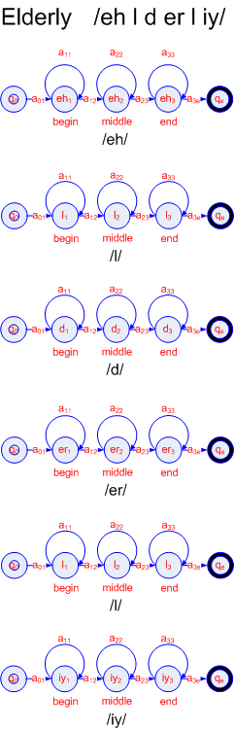
Hand-labeled isolated word training

Slide 229
Hand-labeled Embedded Training
If we are given a training corpus of digits, for example,
each instance of a spoken digit is stored in a wavefile,
start and end of each word are marked, and
phones are hand-segmented,
then, we can compute the B Gaussians observation likelihoods and the A transition probabilities by merely counting in the training data!
The A transition probability are specific to each word, but the B Gaussians would be shared across words if the same phone occurred in multiple words.

Slide 230
Hand-labeled Embedded Training
Unfortunately, hand-segmented training data is rarely used in training systems for continuous speech.
One reason is that it is very expensive to use humans to hand-label phonetic boundaries; it can take up to 400 times real time (i.e. 400 labeling hours to label each 1 hour of speech).
Another reason is that humans don’t do phonetic labeling very well for units smaller than the phone; people are bad at consistently finding the boundaries of sub-phones.
ASR systems aren’t better than humans at finding boundaries, but their errors are at least consistent between the training and test sets.

Slide 231
Embedded Training
Embedded Training:
For this reason, speech recognition systems train each phone HMM embedded in an entire sentence, and the segmentation and phone alignment are done automatically as part of the training procedure.
This entire acoustic model training process is therefore called embedded training. Hand phone segmentation do still play some role, however, for example for bootstrapping initial systems for discriminative (SVM; non-Gaussian, etc.) likelihood estimators, or for tasks like phone recognition.

Slide 232
Training Corpus
In order to train a simple digits system, we’ll need a training corpus of spoken digit sequences.
Wavefiles:
For simplicity assume that the training corpus is separated into separate wavefiles, each containing a sequence of spoken digits.
Transcription File - Correct Sequence of Spoken Digits:
For each wavefile, we’ll need to know the correct sequence of digit words.
We’ll thus associate with each wavefile a transcription (a string of words).
Lexicon
We’ll also need a pronunciation lexicon and a phoneset, defining a set of (untrained) phone HMMs. From the transcription, lexicon, and phone HMMs, we can build a “whole sentence” HMM for each sentence, as shown in Fig. in the next slide.

Slide 233
Embedded Training Example

Slide 234
Embedded Training Baum-Welch Algorithm
Following procedure depicted in the previous slide we are now ready to train the transition matrix A and output likelihood estimator B for the HMMs.
Using Baum-Welch-based paradigm for embedded training of HMMs all what is needed is the training data.
In particular, we don’t need phonetically transcribed data.
We don’t even need to know where each word starts and ends.
The Baum-Welch algorithm will sum over all possible segmentations of words and phones, using ξ_{j}(t), the probability of being in state j at time t and generating the observation sequence O.

Slide 235
Embedded Training Baum-Welch Algorithm
Initial Estimate:
We will, however, need an initial estimate for the transition and observation probabilities a_{ij} and b_{j}(o_{t}). The simplest way to do this is with a flat start.
In flat start, we first set to zero any HMM transitions that we want to be ‘structurally zero’, such as transitions from later phones back to earlier phones. The γ probability computation in Baum-Welch includes the previous value of a_{ij}, so those zero values will never change.
Then we make all the rest of the (non-zero) HMM transitions equiprobable.
Thus the two transitions out of each state (the self-loop and the transition to the following sub-phone) each would have a probability of 0.5.
For the Gaussians, a flat start initializes the mean and variance for each Gaussian identically, to the global mean and variance for the entire training data.

Slide 236
Embedded Training Procedure
Build “whole-sentence” HMM’s (grammar compiler)
Initialize A & B (equal) probabilities (setting means and variances to global mean and variance of entire training set)
Multiple iteration of the Baum-Welch training algorithm

Slide 237
Embedded Training Procedure
Given:
phoneset,
pronunciation lexicon, and
the transcribed wavefiles
Procedure:
Build a “whole sentence” HMM for each sentence, as shown in Fig. Embedded Training Example.
Initialize A probabilities to 0.5 (for loop-backs or for the correct next subphone) or to zero (for all other transitions).
Initialize B probabilities by setting the mean and variance for each Gaussian to the global mean and variance for the entire training set.
Run multiple iterations of the Baum-Welch algorithm

Slide 238
Notes on Baum-Welch Training
Computationally Expensive
The Baum-Welch algorithm is used repeatedly as a component of the embedded training process. Baum-Welch computes ξ_{i}(t), the probability of being in state i at time t, by using forward-backward to sum over all possible paths that were in state i emitting symbol o_{t} at time t. This lets us accumulate counts for re-estimating the emission probability b_{j}(o_{t}) from all the paths that pass through state j at time t. But Baum-Welch itself can be time-consuming.
Viterbi Training
There is an efficient approximation to Baum-Welch training that makes use of the Viterbi algorithm. In Viterbi training, instead of accumulating counts by a sum over all paths that pass through a state j at time t, we approximate this by only choosing the Viterbi (most-probable) path. Thus instead of running EM at every step of the embedded training, we repeatedly run Viterbi.

Slide 239
Forced Alignement
Running the Viterbi algorithm over the training data in this way is called forced Viterbi alignment or just forced alignment.
In Viterbi training (unlike in Viterbi decoding on the test set) we know which word string to assign to each observation sequence, So we can ‘force’ the Viterbi algorithm to pass through certain words, by setting the a_{ij}’s appropriately.
A forced Viterbi is thus a simplification of the regular Viterbi decoding algorithm, since it only has to figure out the correct state (sub-phone) sequence, but doesn’t have to discover the word sequence. The result is a forced alignment:
the single best state path corresponding to the training observation sequence.
We can now use this alignment of HMM states to observations to accumulate counts for re-estimating the HMM parameters.
We saw earlier that forced alignment can also be used in other speech applications like text-to-speech, whenever we have a word transcript and a wave-file in which we want to find boundaries.

Slide 240
Evaluation and Testing
Word and Sentence Error Rate

Slide 241
Word Error Rate
The accuracy of speech recognizers is often measured by word error rate (WER), which uses three measures [1]:
Insertion (INS) – an extra word was inserted in the recognized sentence
Deletion (DEL) – a correct word was omitted in the recognized sentence
Substitution (SUB) – an incorrect word was substituted for a correct word
WER is defined as:

Slide 242
Sentece Error Rate
Less often speech recognizers’ performance is measured by sentence error rate (SER), which is defined as:

Slide 243
Word Error Rate
To compute word error rate one must optimally align the reference (from transcription file) and hypothesized output of the recognizer.
Alignment is performed with minimum edit distance – a Dynamic Programming Algorithm introduced in next chapters.
The standard method for implementing minimum edit distance and computing word error rates is a free script called sclite, available from the National Institute of Standards and Technologies (NIST) (NIST, 2005).

Slide 244
SCLITE
sclite is given a series of reference (hand-transcribed, gold-standard) sentences and a corresponding set of hypothesis sentences.
Besides performing alignments, and computing word error rate, sclite performs a number of other useful tasks. For example,
it gives useful information for error analysis, such as confusion matrices showing which words are often misrecognized for others, and gives summary statistics of words which are often inserted or deleted.
sclite also gives error rates by speaker (if sentences are labeled for speaker id), as well as useful statistics like the sentence error rate, the percentage SENTENCE ERROR of sentences with at least one word error.

Slide 245
Why WUW (Wake-Up-Word) Speech Recognition is Hard!
Taken from http://lovemyecho.com/2017/01/24/cant-make-alexa-wake-word/
The study and analysis of wake words is an entire category of voice synthesis engineering unto itself. Consider this excerpt, “Wake Up Word Recognition” from the book Speech Technologies, ISBN 978-953-307-996-7. This excerpt is from a chapter written by Veton Kepuska:
[A Wake Up Word] has the following unique requirement: Detect a single word or phrase when spoken in an alerting context, while rejecting all other words, phrases, sounds, noises and other acoustic events with virtually 100% accuracy including the same word or phrase of interest spoken in a non-alerting (i.e. referential) context.

Slide 246
Why WUW Speech Recognition is Hard!
Doesn’t sound so simple now, does it?
In choosing wake words, Alexa engineers had to find words that were not only easy for the user to pronounce and remember, but were also unusual enough that they’re not commonly used at the start of sentences. Remember, emphasis plays a part in this too; hence that “virtually 100% accuracy including the same word or phrase of interest spoken in a non-alerting (i.e. referential) context” bit.

Slide 247

References
http://www.intechopen.com/books/speech-technologies/wake-up-word-speech-recognition Veton Këpuska, Florida Institute of Technology, ECE Department Melbourne, Florida 32931, DOI: 10.5772/16242
Huang, Xuedong, Acero, Alex and Hon, Hsiao-Wuen. Spoken Language Processing: A Guide to Theory, Algorithm and System Development. s.l. : Prentice Hall PTR, 2001.
Jurafsky D., Martin J. An Instruction to Natural Language Processing Computation Linguistics, and Speech Recognition, Prentice Hall, 2005

Slide 248
END

